Slide 1
CPI/PPI Index Comparisons

Slide 2
Who are we? …DOL
Domingo
Kevin
Jeff
BLS – yadda, yadda
ETA – yadda, yadda
BLS – yadda, yadda

Slide 3
What is the CPI?
Consumer Price Index
Inflation measured from an end consumer via a basket of goods.
Monthly Data

Slide 4
How is the CPI used?
Cost of Living Adjustments
Etc.

Slide 5
What is the PPI?
Producer Price Index
Inflation measured in domestic industries at earlier stages of production.
Monthly Data

Slide 6
How is the PPI used?
Contract Escalation
Etc.

Slide 7
Differences in the CPI and PPI
https://www.bls.gov/ppi/ppicpippi.htm
Scope / Coverage
Categorization
Other Technical Aspects
Data collection continuous versus once a month.
Yadda, yadda, yadda
https://www.investopedia.com/ask/answers/08/ppi-vs-cpi.asp

Slide 8
Price Change “Pass Through”
https://www.bls.gov/ppi/ppivcpi.pdf
Some assume that a price change recorded in a particular component of the PPI will eventually and directly be seen in the same or most similar component of the CPI. In reality, it is difficult to project whether, in what magnitude, or when an increase in the PPI will “pass through” to the CPI. An increase in the price paid to a producer for a good may not be passed on by a retailer if, for example, competitive conditions in the retail market preclude such an action. Alternatively, the retailer may increase the selling price for the good in question, but not by the full extent of the increase in the price paid to the producer. In this case, for example, the retailer may be realizing efficiencies in operations which allow a shrinkage in markup.

Slide 9
CPI/PPI Comparisons
Comparison Examples:
Profitability Increase from Increasing Spread

Slide 10
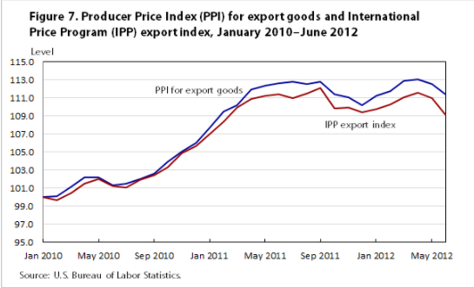
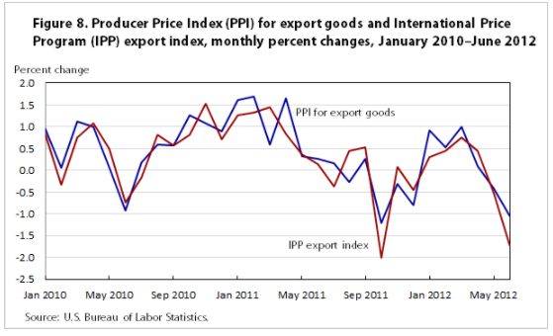
CPI/PPI Comparisons
https://www.bls.gov/opub/mlr/2014/article/comparing-new-final-demand-producer-price-indexes-with-other-government-price-indexes.htm

Slide 11
Data Sources
CPI and PPI Index Published

Slide 12
Procedure
For each Index in CPI and PPI being considered collect monthly Index Values for last two years (24months).
Calculate %change month to month if not already available.
Set a window of months to compare: perhaps ~4,6,8,10,12 at a time.
Take one CPI Index and one PPI Index: compare same month to same month, but also offset (for example CPI Month = PPI Month+1)… then compare again (CPI Month = PPI Month +2), (CPI Month = PPI Month + 3), etc.
For each comparison, what is the cumulative spread of the % changes for all the months in the comparison window. The less the spread the closer match we are seeing.

Slide 13
What might we see?
Many or even most Indexes just randomly test would have little relation to each other.
Those that do match up may indicate something that is already obvious – Maybe the Meats PPI Index leads to Grocery CPI Index follow through inflation.
We might be able to say Inflation follow through here is most relevant in the month following.
We might be able to say from PPI Petroleum to CPI Gasoline the closet match for follow through of price change is the current month.
Maybe we find others that have a closest measure seeing a follow through a 3 months, or 6 months delayed?
The algorithm may suggest relationships between Indices that are in-explicable. Some of these might be simple dismissed as illogical or used as a pointer for future study (by someone else ☺)

Slide 14
Visualizations
Close Matches could be shown in line chart form… time adjusted for time lag.
All comparisons could be ploted by our calculated gap metric… by # of months in the window.
Etc.

